Slide 1
Text-related CSS Properties
color – specifies the color of the text
font-size – size of font: xx-small, x-small, small, medium, large, x-large, xx-large, smaller, larger or numeric value
font-family – comma separated font names
  Example: verdana, sans-serif, etc.
  The browser loads the first one that is available
  There should always be at least one generic font
font-weight can be normal, bold, bolder, lighter or a number in range [100 … 900]
1

Slide 2
CSS Rules for Fonts (2)
font-style – styles the font
  Values: normal, italic, oblique
text-decoration – decorates the text
  Values: none, underline, line-trough, overline, blink
text-align – defines the alignment of text or other content
  Values: left, right, center, justify

Slide 3
Shorthand Font Property
font
  Shorthand rule for setting multiple font properties at the same time
  is equal to writing this:
font:italic normal bold 12px/16px verdana
font-style: italic;
font-variant: normal;
font-weight: bold;
font-size: 12px;
line-height: 16px;
font-family: verdana;

Slide 4
Backgrounds
background-image
  URL of image to be used as background, e.g.:
background-color
  Using color and image and the same time
background-repeat
  repeat-x, repeat-y, repeat, no-repeat
background-attachment
  fixed / scroll
background-image:url("back.gif");

Slide 5
Backgrounds (2)
background-position: specifies vertical and horizontal position of the background image
  Vertical position: top, center, bottom
  Horizontal position: left, center, right
  Both can be specified in percentage or other numerical values
  Examples:
background-position: top left;
  background-position: -5px 50%;

Slide 6
Background Shorthand Property
background: shorthand rule for setting background properties at the same time:
is equal to writing:
  Some browsers will not apply BOTH color and image for background if using shorthand rule
background: #FFF0C0 url("back.gif") no-repeat fixed top;
background-color: #FFF0C0;
background-image: url("back.gif");
background-repeat: no-repeat;
background-attachment: fixed;
background-position: top;

Slide 7
Background-image or <img>?
Background images allow you to save many image tags from the HTML
  Leads to less code
  More content-oriented approach
All images that are not part of the page content (and are used only for "beautification") should be moved to the CSS

Slide 8
Borders
border-width: thin, medium, thick or numerical value (e.g. 10px)
border-color: color alias or RGB value
border-style: none, hidden, dotted, dashed, solid, double, groove, ridge, inset, outset
Each property can be defined separately for left, top, bottom and right
  border-top-style, border-left-color, …

Slide 9
Border Shorthand Property
border: shorthand rule for setting border properties at once:
is equal to writing:
Specify different borders for the sides via shorthand rules: border-top, border-left, border-right, border-bottom
When to avoid border:0
border: 1px solid red
border-width:1px;
border-color:red;
border-style:solid;

Slide 10
Width and Height
width – defines numerical value for the width of element, e.g. 200px
height – defines numerical value for the height of element, e.g. 100px
  By default the height of an element is defined by its content
  Inline elements do not apply height, unless you change their display style.

Slide 11
Margin and Padding
margin and padding define the spacing around the element
  Numerical value, e.g. 10px or -5px
  Can be defined for each of the four sides separately - margin-top, padding-left, …
  margin is the spacing outside of the border
  padding is the spacing between the border and the content
  What are collapsing margins?

Slide 12
Margin and Padding: Short Rules
margin: 5px;
  Sets all four sides to have margin of 5 px;
margin: 10px 20px;
  top and bottom to 10px, left and right to 20px;
margin: 5px 3px 8px;
  top 5px, left/right 3px, bottom 8px
margin: 1px 3px 5px 7px;
  top, right, bottom, left (clockwise from top)
Same for padding

Slide 13
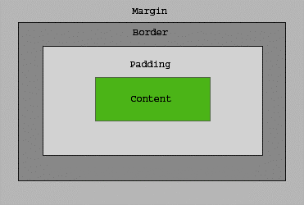
The Box Model

Slide 14
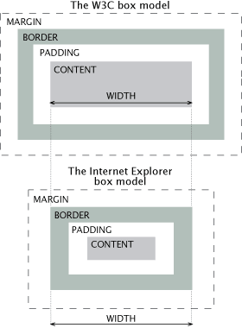
IE Quirks Mode
When using quirks mode (pages with no DOCTYPE or with a HTML 4 Transitional DOCTYPE), Internet Explorer violates the box model standard

Slide 15
Positioning
position: defines the positioning of the element in the page content flow
The value is one of:
  static (default)
  relative – relative position according to where the element would appear with static position
  absolute – position according to the innermost positioned parent element
  fixed – same as absolute, but ignores page scrolling

Slide 16
Positioning (2)
Margin VS relative positioning
Fixed and absolutely positioned elements do not influence the page normal flow and usually stay on top of other elements
  Their position and size is ignored when calculating the size of parent element or position of surrounding elements
  Overlaid according to their z-index
  Inline fixed or absolutely positioned elements can apply height like block-level elements

Slide 17
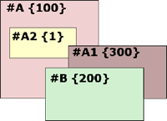
Positioning (3)
top, left, bottom, right: specifies offset of absolute/fixed/relative positioned element as numerical values
z-index : specifies the stack level of positioned elements
  Understanding stacking context
Each positioned element creates a stacking context.
Elements in different stacking contexts are overlapped according to the stacking order of their containers. For example, there is no way for #A1 and #A2 (children of #A) to be placed over #B without increasing the z-index of #A.

Slide 18
Inline element positioning
vertical-align: sets the vertical-alignment of an inline element, according to the line height
  Values: baseline, sub, super, top, text-top, middle, bottom, text-bottom or numeric
  Also used for content of table cells (which apply middle alignment by default)

Slide 19
Float
float: the element “floats” to one side
  left: places the element on the left and following content on the right
  right: places the element on the right and following content on the left
  floated elements should come before the content that will wrap around them in the code
  margins of floated elements do not collapse
  floated inline elements can apply height

Slide 20
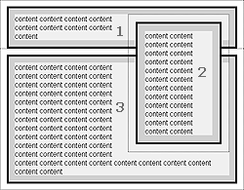
Float (2)
How floated elements are positioned

Slide 21
Clear
clear
  Sets the sides of the element where other floating elements are NOT allowed
  Used to "drop" elements below floated ones or expand a container, which contains only floated children
  Possible values: left, right, both
Clearing floats
  additional element (<div>) with a clear style

Slide 22
Clear (2)
Clearing floats (continued)
  :after { content: ""; display: block; clear: both; height: 0; }
  Triggering hasLayout in IE expands a container of floated elements
    display: inline-block;
    zoom: 1;

Slide 23
Opacity
opacity: specifies the opacity of the element
  Floating point number from 0 to 1
  For old Mozilla browsers use –moz-opacity
  For IE use filter:alpha(opacity=value) where value is from 0 to 100; also, "binary and script behaviors" must be enabled and hasLayout must be triggered, e.g. with zoom:1

Slide 24
Visibility
visibility
  Determines whether the element is visible
  hidden: element is not rendered, but still occupies place on the page (similar to opacity:0)
  visible: element is rendered normally

Slide 25
Display
display: controls the display of the element and the way it is rendered and if breaks should be placed before and after the element
  inline: no breaks are placed before and after (<span> is an inline element)
  block: breaks are placed before AND after the element (<div> is a block element)

Slide 26
Display (2)
display: controls the display of the element and the way it is rendered and if breaks should be placed before and after the element
  none: element is hidden and its dimensions are not used to calculate the surrounding elements rendering (differs from visibility: hidden!)
  There are some more possible values, but not all browsers support them
    Specific displays like table-cell and table-row

Slide 27
Overflow
overflow: defines the behavior of element when content needs more space than you have specified by the size properties or for other reasons. Values:
  visible (default) – content spills out of the element
  auto - show scrollbars if needed
  scroll – always show scrollbars
  hidden – any content that cannot fit is clipped

Slide 28
Other CSS Properties
cursor: specifies the look of the mouse cursor when placed over the element
  Values: crosshair, help, pointer, progress, move, hair, col-resize, row-resize, text, wait, copy, drop, and others
white-space – controls the line breaking of text. Value is one of:
  nowrap – keeps the text on one line
  normal (default) – browser decides whether to brake the lines if needed

Slide 29
Benefits of using CSS
More powerful formatting than using presentation tags
Your pages load faster, because browsers cache the .css files
Increased accessibility, because rules can be defined according given media
Pages are easier to maintain and update

